Slide 1
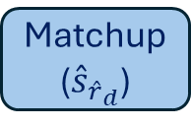


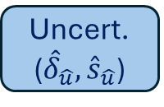

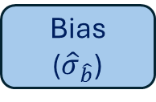







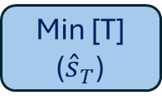

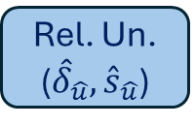

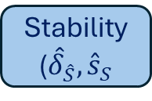
Global
Data
FRMs
Products
${\tilde{ y}}_{i}$, ${\tilde{σ}}_{i}$
${\hat{y}}_{i}$,${\hat{σ}}_{i}$
Daily Estimate
Matchup
(${\hat{s}}_{{\hat{r}}_{d}}$)
${\hat{x}}_{i}$, $x_{i}$
${\tilde{ y}}_{d}$, ${\tilde{s}}_{d}$
${\hat{r}}_{d}$,${\hat{σ}}_{{\hat{r}}_{d}}$
Inclusion Prob.
Min [T]
(${\overset{ˆ}{s}}_{T}$)
${\hat{π}}_{i}$, $π_{i}$
${\hat{e}}_{T}$,${\hat{σ}}_{{\hat{e}}_{T}}$
Bias
(${\hat{σ}}_{\hat{b}}$)
${\hat{b}}_{i}$,${\hat{σ}}_{{\hat{b}}_{i}}$
Stability
(${\hat{δ}}_{\hat{S}},{\hat{s}}_{S}$
Uncert.
(${\hat{δ}}_{\hat{u}},{\hat{s}}_{\hat{u}}$)
Rel. Un.
(${\hat{δ}}_{\hat{u}},{\hat{s}}_{\hat{u}}$)
${\hat{S}}_{i}$,${\hat{σ}}_{{\hat{S}}_{i}}$
${\hat{u}}_{i}$,${\hat{σ}}_{{\hat{u}}_{i}}$
$${\hat{u}}_{r,i},{\hat{σ}}_{{\hat{u}}_{r,i}}$$
Tolerance
Interval
Prob.
Conform.
$${\hat{p}}_{c,i}$$
Notes:
Figure 1. Flowchart illustrating the components contributing to stability, standard uncertainty, relative standard uncertainty and associated conformity probabilities.. Grey shapes correspond to data or user provide inputs. Blue shapes correspond to algorithm modules. Clear shapes correspond to inputs or outputs from algorithm modules. Symbols are defined in Supplementary Material S2.

Slide 2
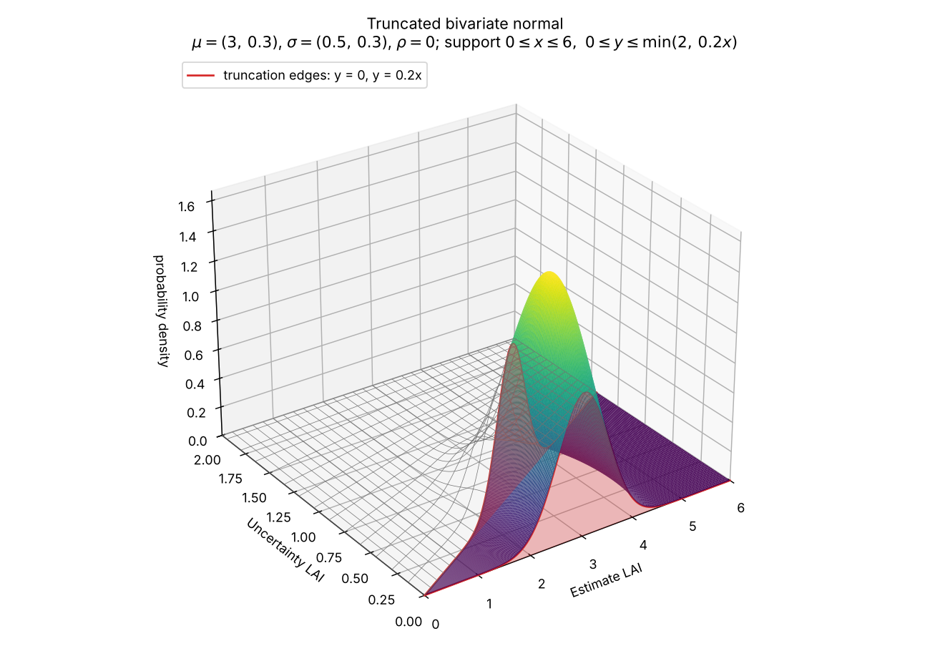
Notes:
Figure 2. Estimation of probability of a measurement conforming with requirements for LAI as the probability mass of the estimated statistics (here uncertainty LAI) satisfying user requirements.

Slide 3
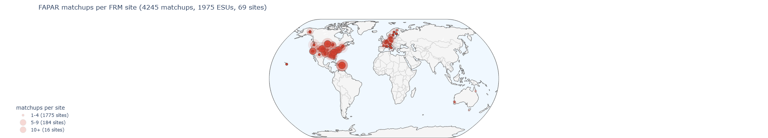

(a)
(b)
Notes:
Figure 3. Number of matchups and ESUs per site for (a) HLS L30 fundamental data records and (b) HLS S30 fundamental data records.

Slide 4
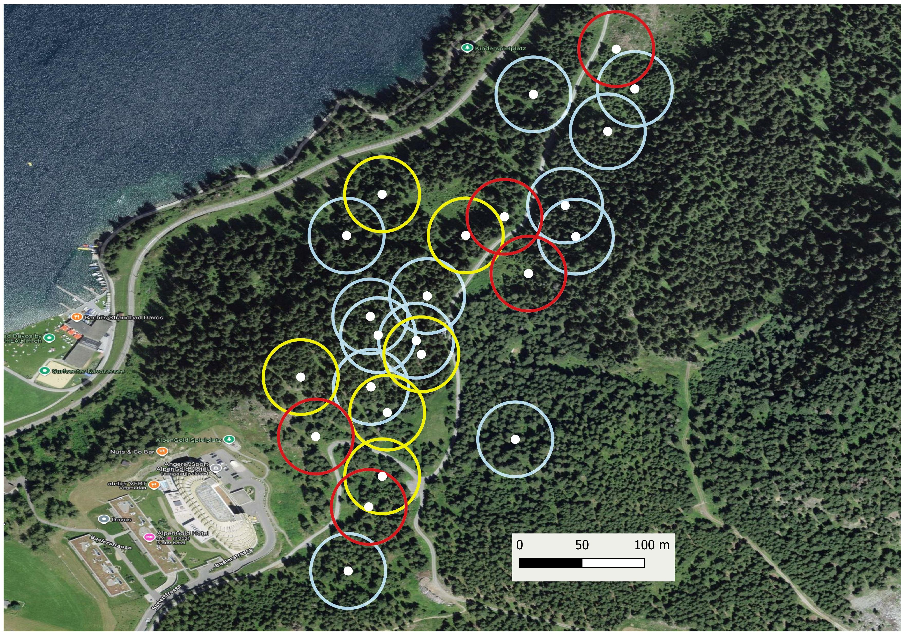
ESU Centre
Homogeneous
Heterogeneous >30m
Heterogeneous <30m
Notes:
Figure 4. Qualitative evaluation of ESU heterogeneity for the DAVOS Grounded EO site.

Slide 5
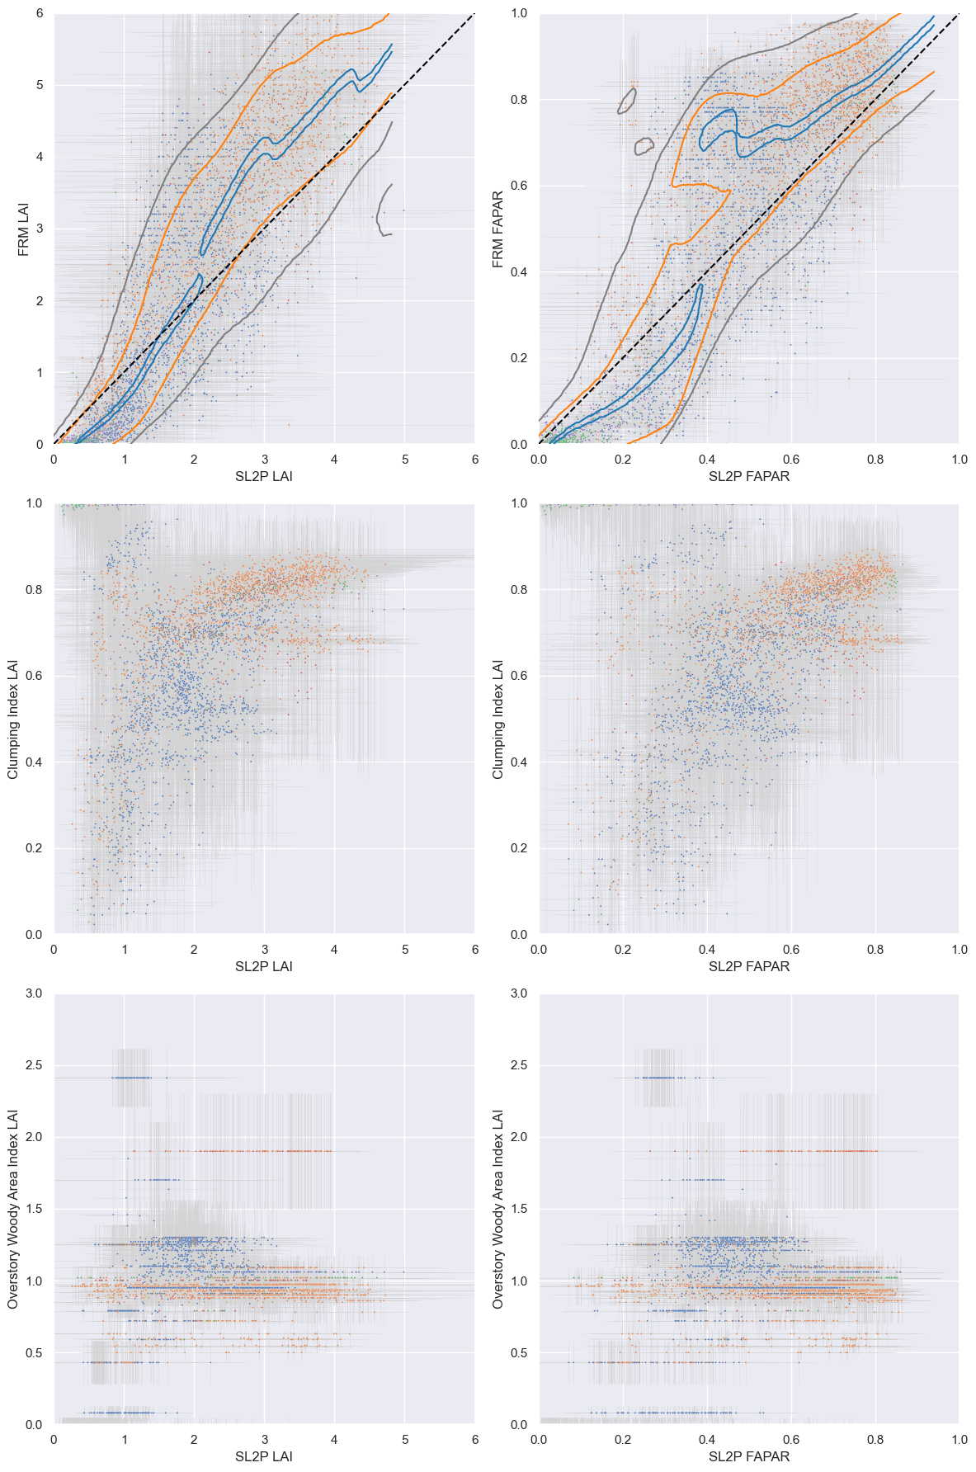
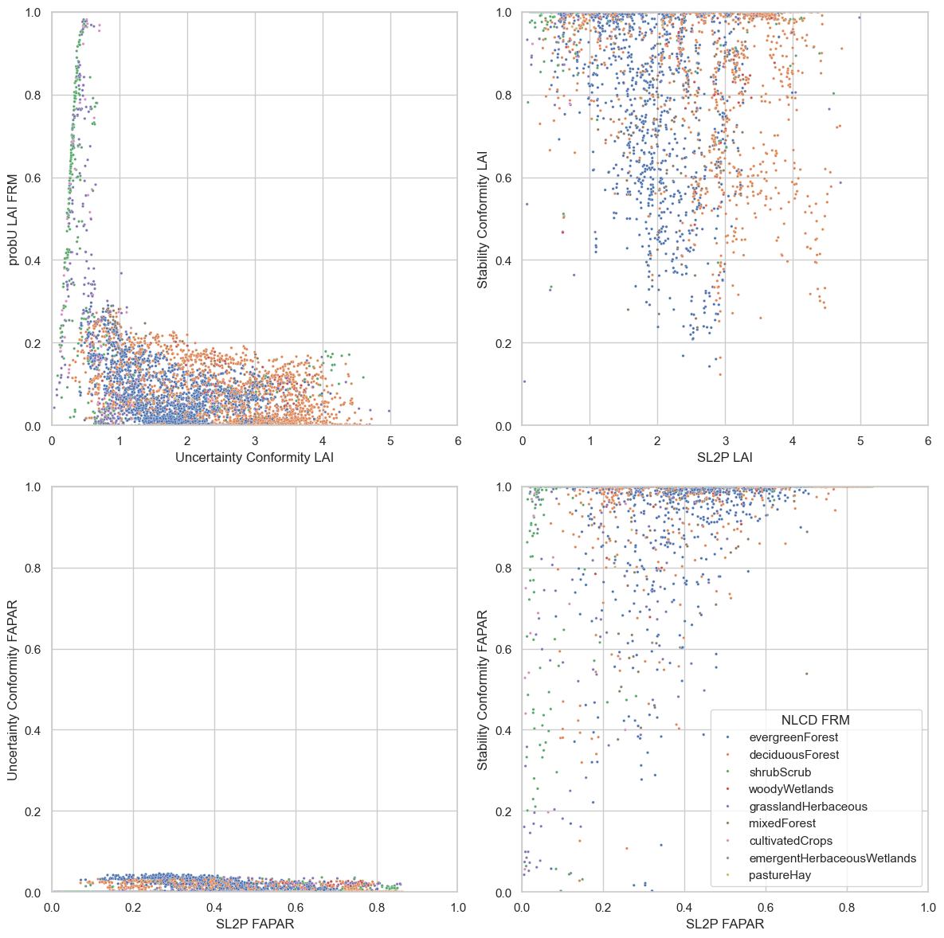
(a)
(b)
(c)
(d)
(e)
(f)
Notes:
Figure 5 Scatter plot of HLS Estimates for (a) FRM LAI (c ) FRM clumping index, e) FRM woody area index versus SL2P LAI and (b) FRM FAPAR (d ) FRM clumping index, f) FRM woody area index versus SL2P FAPAR, coloured by land cover class. Contours indicate 0.1 (blue),, 0.67 (orange) and 0.90 (grey) cumulative conditional probablity of bias given FRM. . Whiskers in panels (a) and (b) indicate one standard deviation intervals of estimates or FRM. Common land cover legend included in panel (f).

Slide 6
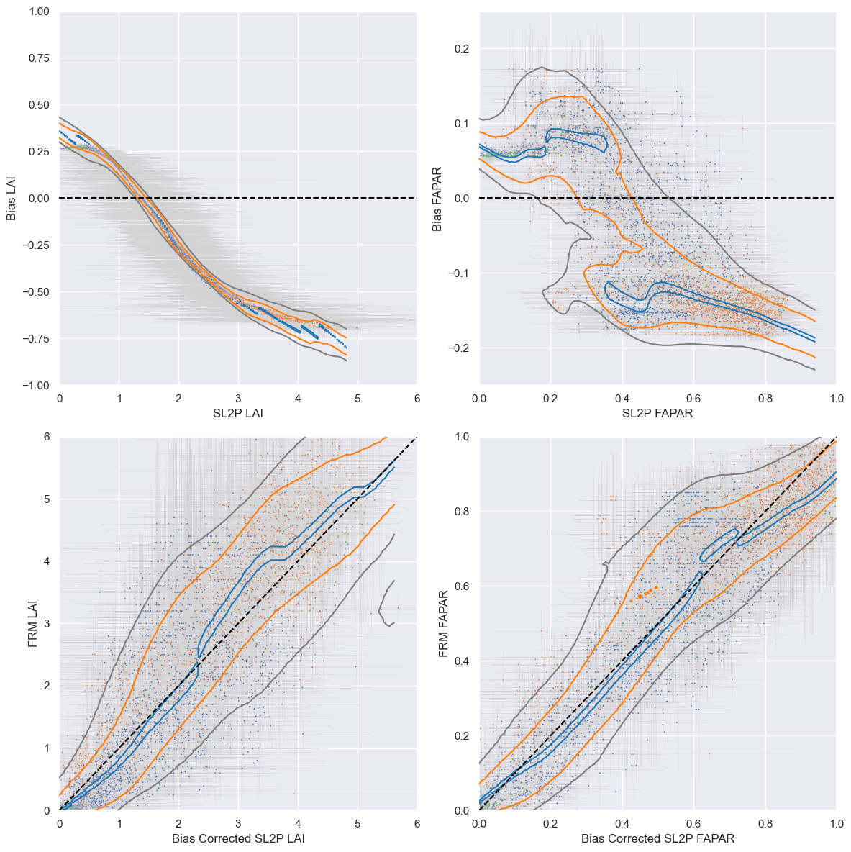
(a)
(b)
(c)
(d)
Notes:
Figure 6. Scatter plots of (a) LAI Bias versus SL2P LAI (b) FAPAR Bias versus SL2P FAPAR (c) FRM LAI versus Bias Corrected SL2P LAI and (d) FRM FAPAR versus Bias Corrected SL2P FAPAR. Contours indicate 0.1 (blue),, 0.67 (orange) and 0.90 (grey) cumulative conditional probability of y-variable given x-variable. Whiskers indicate one standard deviation intervals of estimates or FRM. Common land cover legend indicated in panel (d),.

Slide 7
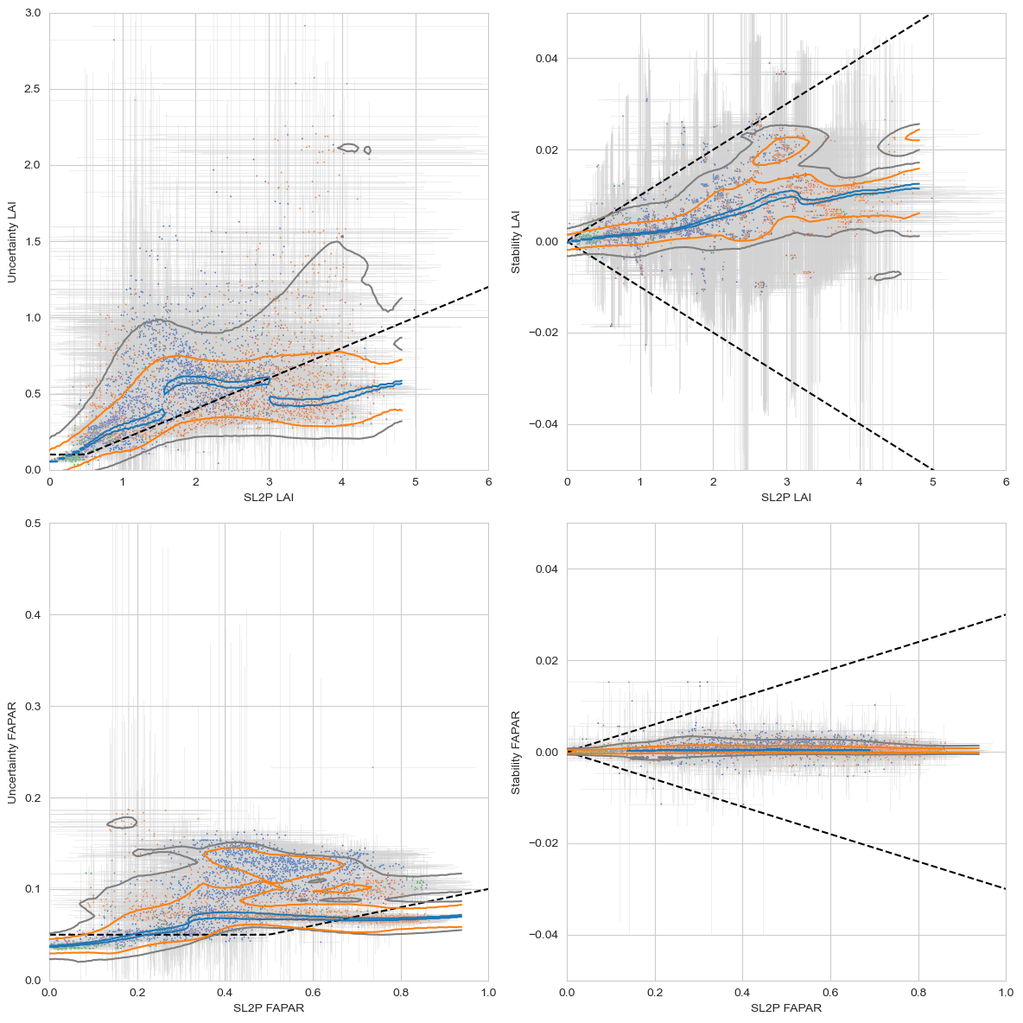
(a)
(b)
(c)
(d)
Notes:
Figure 7. SL2P HLS L30 (a) LAI uncertainty,(b) LAI stability, (c ) FAPAR uncertainty and (d) FAPAR stability estimated over matchups. Contours indicate 0.67 (orange) and 0.90 (grey) cumulative conditional probablity of bias given FRM. Blue line indicates weighted median bias conditional on FRM. Whiskers indicate one standard deviation intervals of estimates or FRM. Common land cover legend included in panel (d). Dashed black line indicates GCOS threshold requirement.

Slide 8
(a)
(b)
(c)
(d)
Notes:
Figure 8. Probability of SL2P HLS L30 measurements over matchups conforming to GCOS threshold requirements for (a) LAI uncertainty , (b) LAI stability, © FAPAR uncertainty and (d) FAPAR stability. . Common land cover legend included in panel (d).

Slide 9
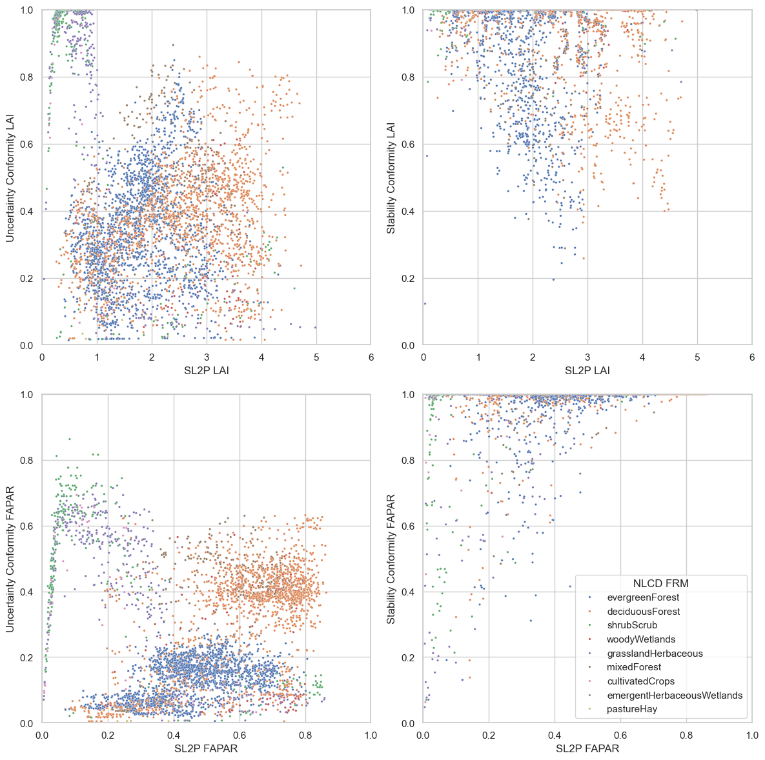
(a)
(b)
(c)
(d)
Notes:
Figure 9. Probability of SL2P HLS L30 measurements over matchups conforming to GCOS threshold requirements for (a) LAI uncertainty , (b) LAI stability, (c ) FAPAR uncertainty and (d) FAPAR stability assuming zero expected value of uncertainty and stability for a matchup but keeping confidence interval of estimates. Common land cover legend included in panel (d).

Slide 10
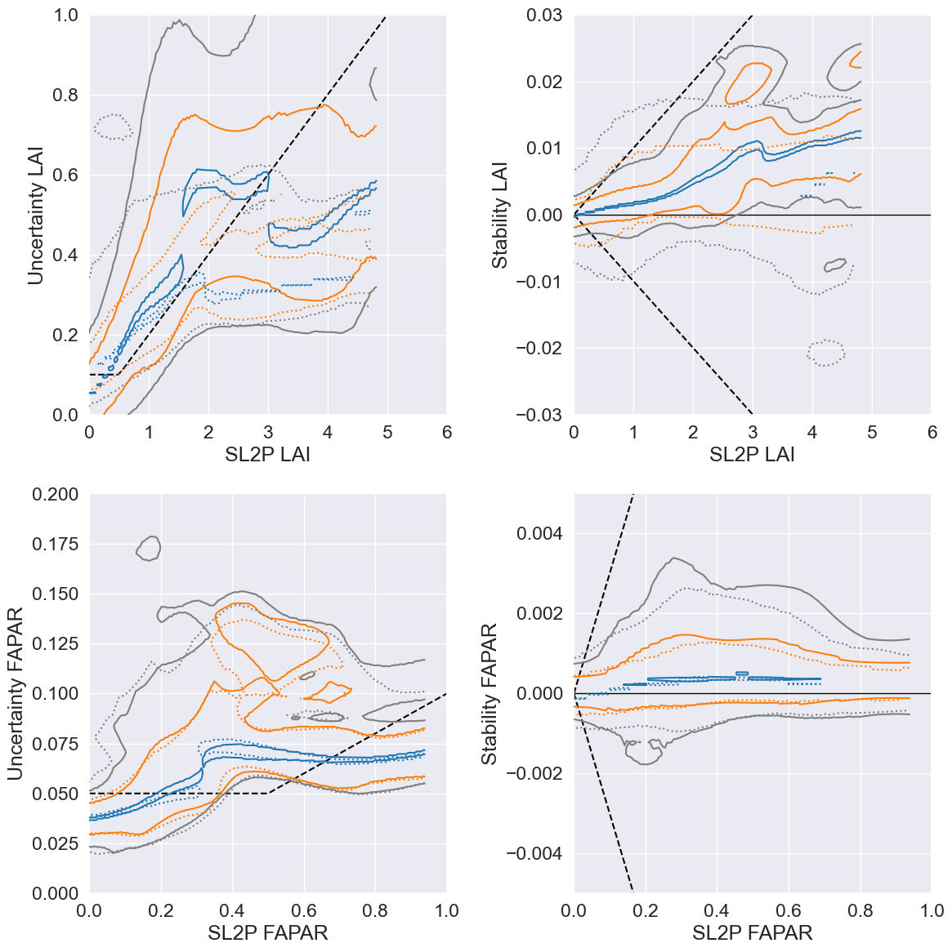
(a)
(b)
(c)
(d)
Notes:
Figure 10. Contour plots of SL2P HLS L30 (solid lines) and SL2P HLS S2 (dotted lines) product estimates for (a) LAI uncertainty, (b) LAI stability, (a) LAI uncertainty, (b) LAI stability versus SL2P estimate. Uncertainty and stability are estimated all FRM measurements and all parameters . . Contours indicate 0.67 (orange) and 0.90 (grey) cumulative conditional probability of uncertainty or stability given corresponding SL2P estimates of product measurements. Black dashed lines correspond to modified GCOS threshold requirements.

Slide 11
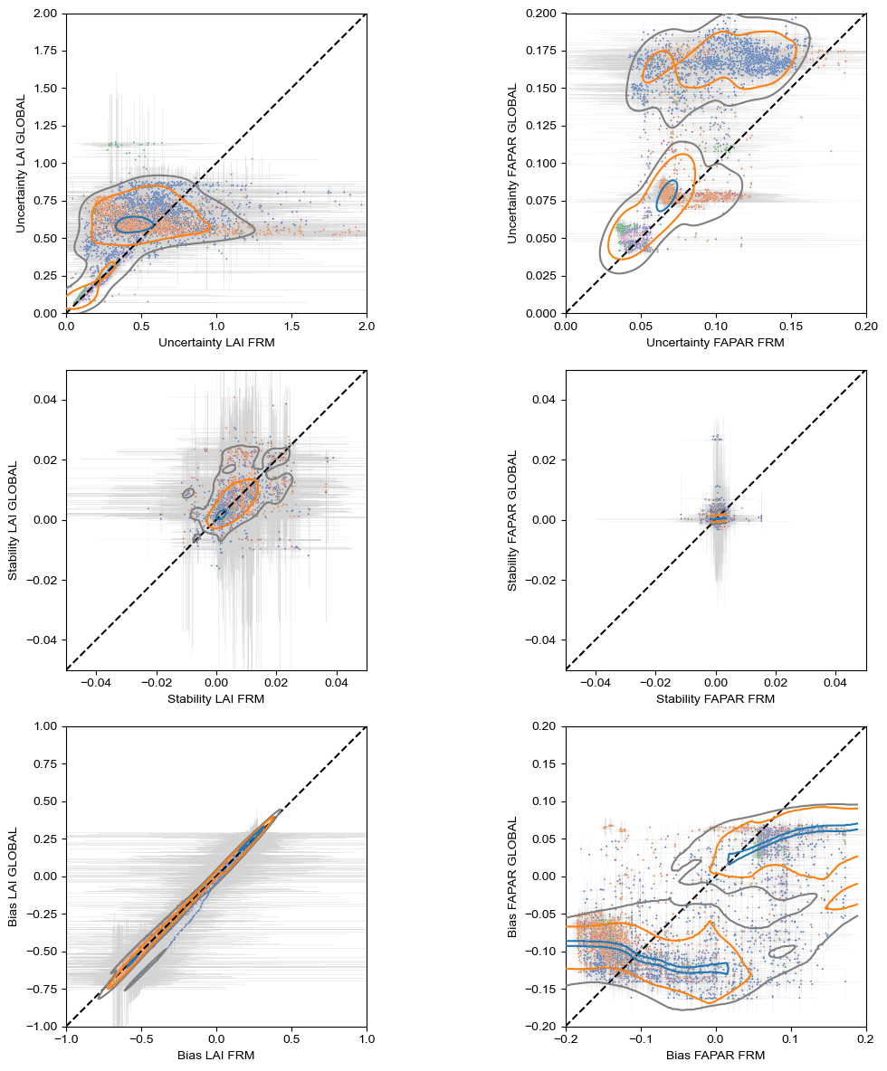
(a)
(b)
(c)
(d)
Notes:
Figure 11. Comparison of (a) LAI Uncertainty, (b) LAI Stability, (c ) FAPAR Uncertainty and (d) FAPAR stability as a function of product measurement using estimates and parameters based on all FRM measurements FRM, x-axis) versus estimates based on FRM measurements at other sites and only global parameters (GLOBAL, y-axis). . Contours indicate joint central probablity mass fractions for 0.1 (blue), 0.67 (orange) and 0.9 (grey). Whiskers indicate one standard deviation intervals of estimates. Black dashed line corresponds to 1L1 line. Points are coloured by land cover with common legend indicated in panel (d),.

Slide 12
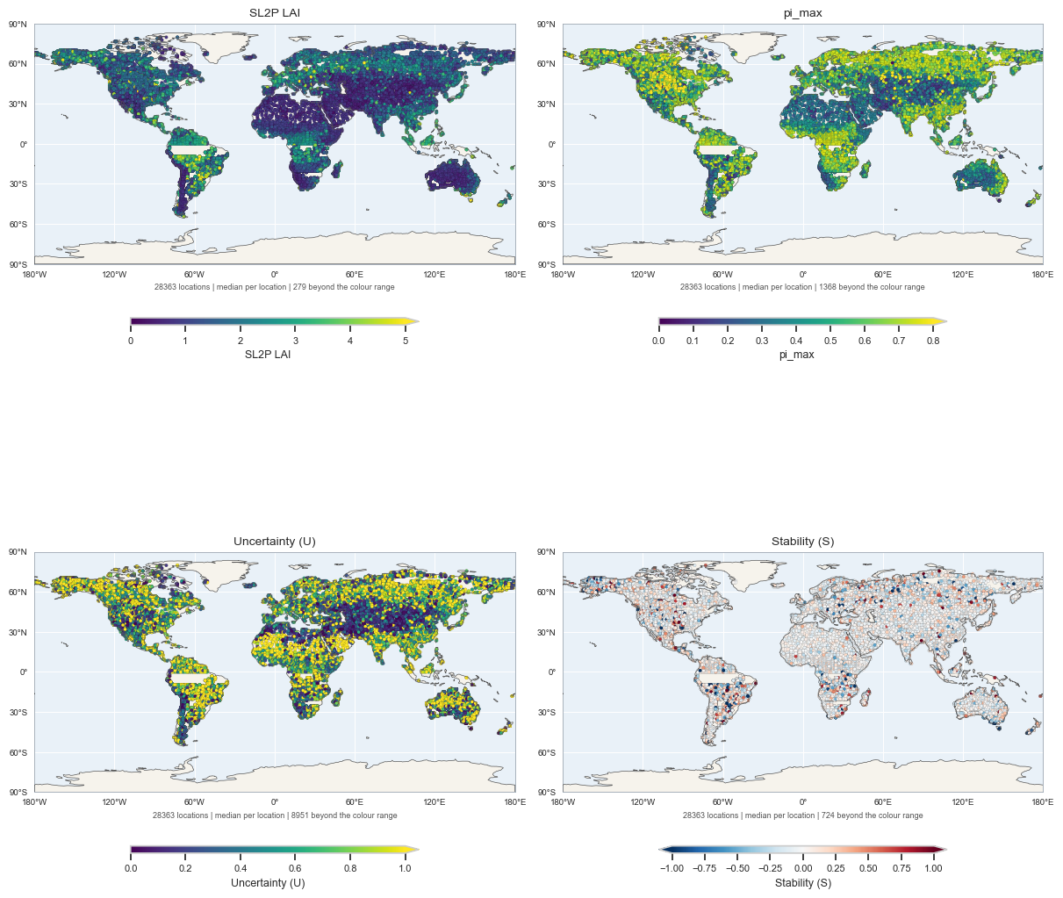
(a)
(b)
(c)
(d)
Notes:
Figure 12 . Global 100km grid samples of (a) maximum SL2P HLS L30 LAI and associated (b) inclusion probability, (c ) uncertainty and (d) stability.

Slide 13
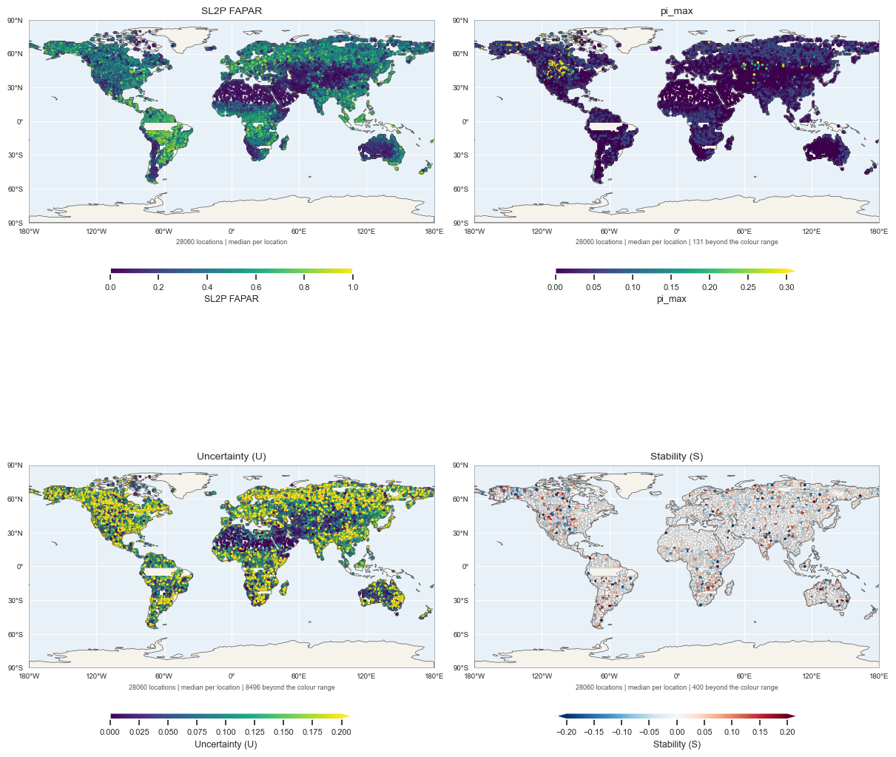
(a)
(b)
(c)
(d)
Notes:
Figure 13. Global 100km grid samples of (a) maximum SL2P HLS L30 FAPAR and associated (b) inclusion probability, (c ) uncertainty and (d) stability.

